Slide 1

WEB Development
Grade 7&8

Slide 2
Recap of the last Class
Notes:
Objective:
Inform the student we will continue with the project
We will cover the remaining CSS styling today
Teacher Notes:
HTML Document Structure:
Tags Covered: <!DOCTYPE html>, <html>, <head>, <meta>, <title>, <link>, <body>
Explanation: Discussed the basic structure of an HTML document, including the doctype declaration, the HTML root element, and the head section with metadata and links to CSS files.
Header and Navigation:
Tags Covered: <header>, <nav>, <ul>, <li>, <a>, <div>
Explanation: Created a header with a navigation bar using list items for navigation links. Implemented a dropdown menu within the navigation bar.
Basic CSS Styling:
Properties Covered: font-family, margin, padding, background-color, color, text-align, box-shadow, display, list-style-type, text-decoration, hover
Explanation: Applied basic CSS styles to the body and header, including setting fonts, colors, padding, margins, and hover effects for the navigation links.

Slide 3
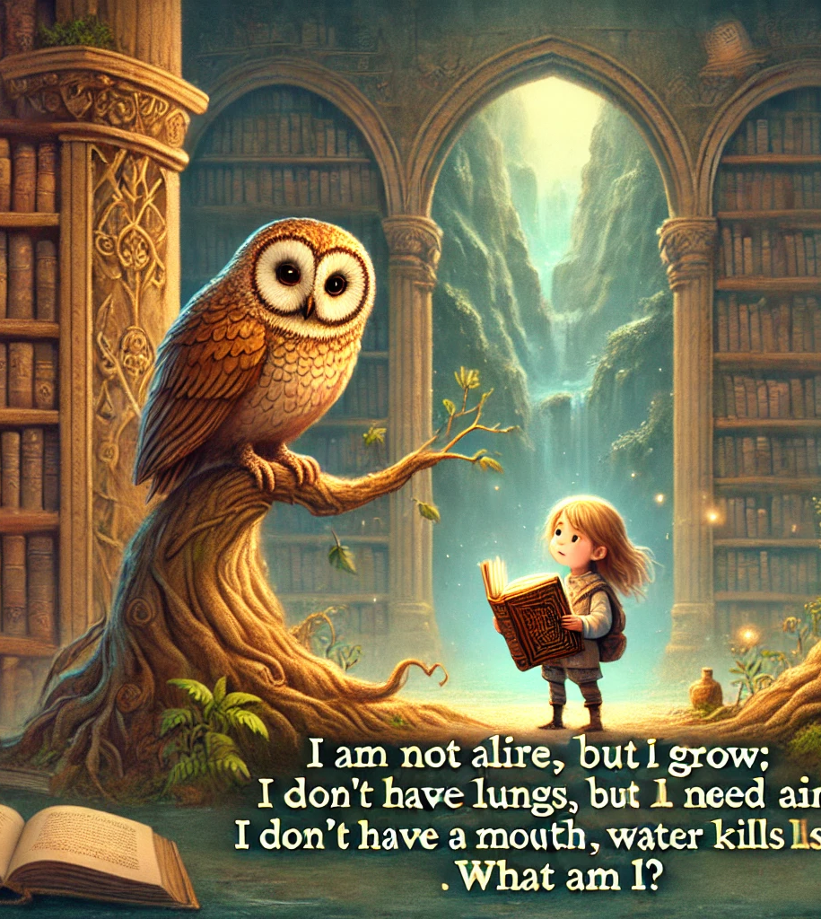
The Mystery of the Ancient Library
In an ancient library hidden deep within a mountain, a young explorer named Lily found an old, dusty book with a golden lock. The wise librarian, an old owl named Orion, offered to unlock the book if Lily could solve a riddle.
Orion's riddle was:
"I am not alive, but I grow; I don’t have lungs, but I need air; I don’t have a mouth, yet water kills me. What am I?"
Can you help Lily solve Orion's riddle to unlock the mysterious book?
Notes:
Objective:
Answer: Fire
Inform student to read the story clearly and think about something which fits in it
Objective:
To develop problem-solving skills by solving a riddle related to the story.

Slide 4

Introduction to Drop down menu
Notes:
Objective:
Introduce the concept of drop down menu
Learning Objectives:
Purpose: Understand that dropdown menus organize many options in a small space, making websites easier to navigate.
Components: Recognize the parts of a dropdown menu, including the main button and the list of options.
Usage: Explore how dropdown menus enhance user experience by providing easy access to different sections.
Creation: For older students, introduce the basics of creating a dropdown menu using HTML and CSS.

Slide 5
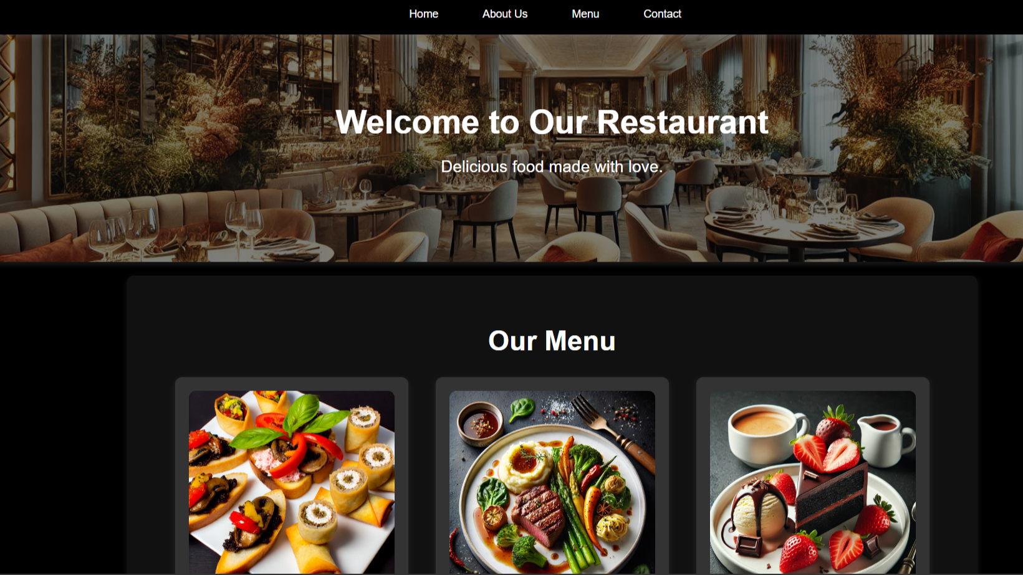
Project – Restaurant Menu
Notes:
Project Link: Restaurant Menu
Objective:
Present the final project example.
Teacher Instructions:
Show the Screenshot:
Display the screenshot of the final project example.
Show the Project in Live Action:
Demonstrate the project on a live website to show how it functions.
Navigate through the website to showcase the drop down menu in action.
Emphasize the importance of drop down menu.
Explain the Project:
Inform students that they will create a similar project.
Highlight the key features:
A clear and user-friendly drop down menu.
An engaging webpage.

Slide 6
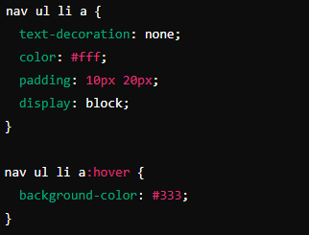
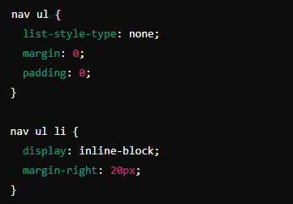
Working with the Project
CSS Code Explanation:
Navigation Menu Styling
Notes:
Objective:
Project Link: Restaurant Menu
Explain body and header Styles:
Teacher Instructions:
Display the screenshot of the CSS code.
Explain the styling for the Navigation Menu:
nav ul: Styles the unordered list within the navigation bar.
list-style-type: none;: Removes the default list styling (bullets or numbers).
margin: 0;: Removes the default margin from the unordered list.
padding: 0;: Removes the default padding from the unordered list.
nav ul li: Styles the list items within the navigation bar.
display: inline-block;: Displays list items in a horizontal line (inline-block).
margin-right: 20px;: Adds a 20-pixel margin to the right of each list item.
nav ul li a: Styles the anchor tags within the list items.
text-decoration: none;: Removes the default underline from links.
color: #fff;: Sets the text color to white.
padding: 10px 20px;: Adds padding of 10 pixels vertically and 20 pixels horizontally.
display: block;: Displays the links as block elements, making the entire area clickable.
nav ul li a:hover: Styles the anchor tags when hovered over.
background-color: #333;: Changes the background color to dark gray on hover.

Slide 7
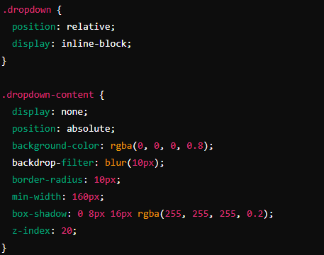
Working with the Project
CSS Code Explanation: Dropdown Menu Styling Part 1
Notes:
Objective:
Project Link: Restaurant Menu
Explain body and header Styles:
Teacher Instructions:
Display the screenshot of the CSS code.
Explain the styling for the Drop Menu:
.dropdown: Styles the dropdown container.
position: relative;: Positions the dropdown relative to its normal position to contain the dropdown content.
display: inline-block;: Displays the dropdown as an inline-block element.
.dropdown-content: Styles the hidden dropdown menu.
display: none;: Hides the dropdown content by default.
position: absolute;: Positions the dropdown content absolutely within the dropdown container.
background-color: rgba(0, 0, 0, 0.8);: Sets a semi-transparent black background.
backdrop-filter: blur(10px);: Adds a blur effect to the background.
border-radius: 10px;: Rounds the corners of the dropdown content.
min-width: 160px;: Sets the minimum width to 160 pixels.
box-shadow: 0 8px 16px rgba(255, 255, 255, 0.2);: Adds a shadow effect with specified offset, blur, and color.
z-index: 20;: Ensures the dropdown content is above other elements by setting a high stacking order.

Slide 8
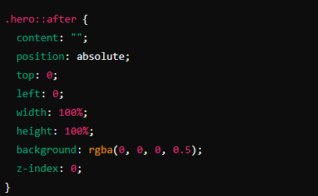
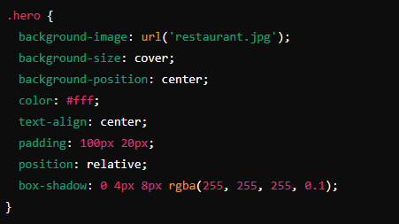
Working with the Project
CSS Code Explanation: Hero Section Styling Part 1
Notes:
Objective:
Project Link: Restaurant Menu
Explain body and header Styles:
Teacher Instructions:
Display the screenshot of the CSS code.
Explain the styling for the Hero Section:
.hero: Styles the hero section.
background-image: url('restaurant.jpg');: Sets the background image.
background-size: cover;: Ensures the background image covers the entire section.
background-position: center;: Centers the background image.
color: #fff;: Sets the text color to white.
text-align: center;: Centers the text horizontally.
padding: 100px 20px;: Adds padding of 100 pixels on top and bottom, and 20 pixels on left and right.
position: relative;: Ensures the section has its own stacking context.
box-shadow: 0 4px 8px rgba(255, 255, 255, 0.1);: Adds a shadow effect with specified offset, blur, and color.
.hero::after: Adds a dark overlay to the hero section using a pseudo-element.
content: "";: Creates an empty pseudo-element.
position: absolute;: Positions the overlay absolutely within the hero section.
top: 0;: Aligns the overlay to the top.
left: 0;: Aligns the overlay to the left.
width: 100%;: Makes the overlay cover the full width.
height: 100%;: Makes the overlay cover the full height.
background: rgba(0, 0, 0, 0.5);: Adds a semi-transparent black background.
z-index: 0;: Sets the overlay behind the text.

Slide 9
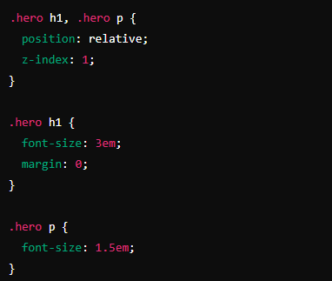
Working with the Project
CSS Code Explanation: Hero Section Styling Part 2
Notes:
Objective:
Project Link: Restaurant Menu
Explain body and header Styles:
Teacher Instructions:
Display the screenshot of the CSS code.
Explain the styling for the Hero Section:
.hero h1, .hero p: Styles the text within the hero section.
position: relative;: Positions the text relative to the hero section.
z-index: 1;: Places the text above the overlay.
.hero h1: Styles the hero section heading.
font-size: 3em;: Sets the font size for the heading.
margin: 0;: Removes the default margin.
.hero p: Styles the hero section paragraph.
font-size: 1.5em;: Sets the font size for the paragraph.

Slide 10
Working with the Project
CSS Code Explanation: Menu Section Styling Part 1
Notes:
Objective:
Project Link: Restaurant Menu
Explain body and header Styles:
Teacher Instructions:
Display the screenshot of the CSS code.
Explain the styling for the Menu Section:
.menu-section: Styles the menu section.
padding: 40px 20px;: Adds padding of 40 pixels on top and bottom, and 20 pixels on left and right.
text-align: center;: Centers the text horizontally.
background-color: #111;: Sets the background color to dark gray.
box-shadow: 0 4px 8px rgba(255, 255, 255, 0.1);: Adds a shadow effect with specified offset, blur, and color.
border-radius: 10px;: Rounds the corners of the section.
margin: 20px auto;: Adds vertical margin and centers the section horizontally.
max-width: 1200px;: Restricts the maximum width of the section.
.menu-section h2: Styles the section heading.
font-size: 2.5em;: Sets the font size for the section heading.
margin-bottom: 20px;: Adds a bottom margin of 20 pixels.
color: #fff;: Sets the text color to white.

Slide 11
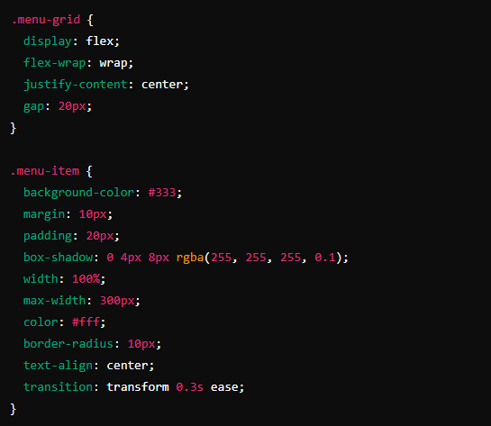
Working with the Project
CSS Code Explanation: Menu Section Styling Part 2
Notes:
Objective:
Project Link: Restaurant Menu
Explain body and header Styles:
Teacher Instructions:
Display the screenshot of the CSS code.
Explain the styling for the Menu Section:
.menu-grid: Sets up a flexible grid layout for menu items.
display: flex;: Uses flexbox to layout the grid items.
flex-wrap: wrap;: Allows the items to wrap onto multiple lines if necessary.
justify-content: center;: Centers the items horizontally within the container.
gap: 20px;: Adds a 20-pixel gap between the grid items.
.menu-item: Styles individual menu items.
background-color: #333;: Sets the background color to dark gray.
margin: 10px;: Adds a 10-pixel margin around each menu item.
padding: 20px;: Adds 20 pixels of padding inside each menu item.
box-shadow: 0 4px 8px rgba(255, 255, 255, 0.1);: Adds a shadow effect with specified offset, blur, and color.
width: 100%;: Sets the width to 100% of the container.
max-width: 300px;: Limits the maximum width to 300 pixels.
color: #fff;: Sets the text color to white.
border-radius: 10px;: Rounds the corners of the menu item.
text-align: center;: Centers the text horizontally within the menu item.
transition: transform 0.3s ease;: Adds a smooth transition effect for transformations.

Slide 12
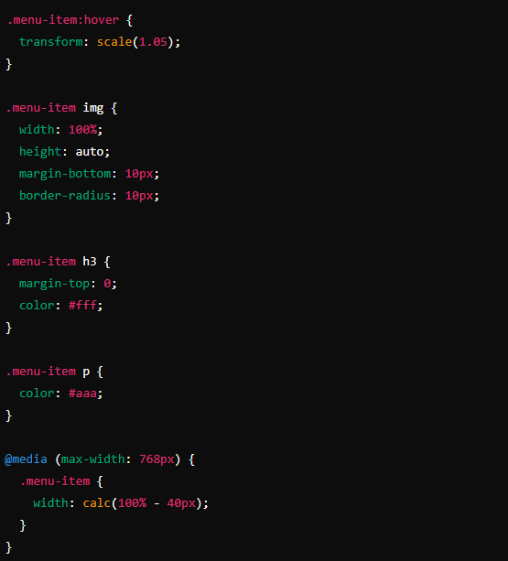
Working with the Project
CSS Code Explanation: Menu Section Styling Part 3
Notes:
Objective:
Project Link: Restaurant Menu
Explain body and header Styles:
Teacher Instructions:
Display the screenshot of the CSS code.
Explain the styling for the Menu Section:
.menu-item:hover: Adds a hover effect to menu items.
transform: scale(1.05);: Slightly enlarges the item when hovered.
.menu-item img: Styles images within menu items.
width: 100%;: Sets the width to 100% of the container.
height: auto;: Maintains the aspect ratio of the image.
margin-bottom: 10px;: Adds a 10-pixel margin below the image.
border-radius: 10px;: Rounds the corners of the image.
.menu-item h3: Styles the menu item headings.
margin-top: 0;: Removes the top margin.
color: #fff;: Sets the text color to white.
.menu-item p: Styles the menu item descriptions.
color: #aaa;: Sets the text color to light gray.
@media (max-width: 768px): Adds responsive styles for small screens.
.menu-item: Sets the width to full width minus margin for menu items on small screens.

Slide 13
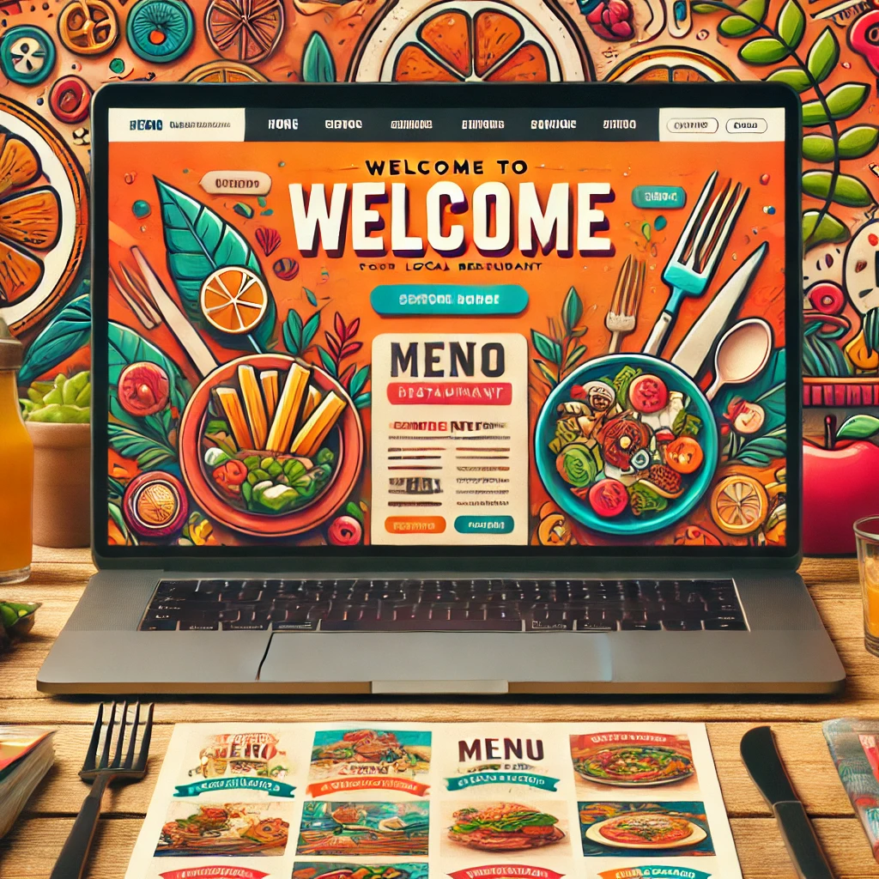
Now it's your turn!
Customize The Project To Look Like Your Local Restaurant
Instructions: Share the code with others and work as a group to give your own personalization to the final web page.
Notes:
"Students' Activity"
Explain that students will create a simple webpage for a local restaurant, including a navigation menu, hero section, and menu section by customizing the Restaraunt Website.

Slide 14

How to Save & Share the project.
Replit offers autosave option – so not worry about the same.
To share project with someone in view mode: just copy the link from the URL bar, and share the link
To share the project for collaboration
Click on "Invite" from the top right corner
If you know the username, type it in the box and click on invite
You can also turn on the toggle button "private join link" to create a public collaboration link and invite members to edit your code.
Notes:
Instructions for the Teacher:
Explain how to save and share projects on Replit, including the options for collaboration.
Emphasize the importance of sharing projects for feedback and collaboration.

Slide 15


What property is used to hide the dropdown content initially?
A) visibility: hidden;
B) opacity: 0;
C) display: none;
D) overflow: hidden;
Notes:
Answer: B) charset

Slide 16
Which property is used to add a smooth transition effect to an element?
A) transform
B) transition
C) animation
D) keyframes
Notes:
Answer: B) transition

Slide 17
What property is used to add a shadow effect to an element?
A) box-shadow
B) text-shadow
C) shadow
D) border-shadow
Notes:
Answer: A) box-shadow

Slide 18
What is the purpose of a media query in CSS?
A) To add animations to elements
B) To change styles based on the device's screen size
C) To hide elements
D) To create flexbox layouts
Notes:
Answer: B) To change styles based on the device's screen size

Slide 19

What have we learnt?
What We Learned Today:
Navigation Menu Styling
Dropdown Menu Styling
Hero Section Styling
Menu Section Styling
Notes:
Objective:
Summarize the key learnings from this and the previous lesson.
Teacher Instructions:
Review the tags and properties
Ask the student to explain the tags and properties one by one
Navigation Menu Styling:
Tags Covered: nav, ul, li, a
CSS Properties Covered: list-style-type, margin, padding, display, text-decoration, color, hover
Explanation: Styled the navigation menu by removing default list styles, setting the items to display inline, and adding padding and hover effects to the links.
Dropdown Menu Styling:
Tags Covered: div, a
CSS Properties Covered: position, display, background-color, border-radius, box-shadow, z-index, hover
Explanation: Created a dropdown menu by positioning it absolutely within the navigation bar, setting its initial display to none, and adding styles for hover interactions.
Hero Section Styling:
Tags Covered: section, h1, p
CSS Properties Covered: background-image, background-size, background-position, color, text-align, padding, box-shadow, position, z-index
Explanation: Styled the hero section with a background image, centered text, padding, and a dark overlay using a pseudo-element.
Menu Section Styling:
Tags Covered: section, div, img, h3, p
CSS Properties Covered: padding, text-align, background-color, box-shadow, border-radius, margin, max-width, display, flex-wrap, justify-content, gap, hover, transform, width, height, media queries
Explanation: Styled the menu section with a flexible grid layout, individual menu items with padding and hover effects, and responsive design using media queries.

Slide 20

Homework Discussion
Notes:
Instructions for the Teacher: Facilitate a discussion about the homework assignment.

Slide 21

Brain Booster Bonus
Create an Interactive Contact Form
Enhance Restaurant website by adding an interactive contact form use previous lesson learning and add the contact form in contact section of navbar
Notes:
Objective: Explain that students will create a contact form for the restaurant website, which allows users to send messages or inquiries.

Slide 22

Be Skeptical of Promises
If something online sounds too good to be true, like 'free games for life,' it could be a trick.
Oliver saw an ad online promising "free games for life" and eagerly clicked on it, hoping for a great deal.
Instead, his computer got infected with malware, causing a lot of problems.
The moral of the story: don't believe ads or emails promising free stuff without checking with an adult first, as it could be a trick.

